Slide 1
Pareto and Cause & Effect Diagram (Fishbone diagram)
Masters in Data Science

Slide 2
Case Study-2

Slide 3
Feedback Result
Using Pareto Analysis and Cause-and-Effect Diagrams analyze the data and present your conclusions about the source of dissatisfaction among AFL fans.
Note:
1. A step by step analysis is to be shown. Also remember proper interpretation of the result is to be shown.
2. Chart should be properly colored as per the brand mentioned in the problem.
3. Each detailed aspect should be properly checked based on the case study.
4. After your analysis only, presentation is to be submitted, no excel sheet.
5. Presentation should be properly designed based on the brand mentioned.

Slide 4
Solution
Feedback was collected in the form of rating (Ordinal data).
“0” was meant for “very poor” and “4” was meant for “very good”.
The other middle numbers can be considered as below.
“1” was for “Poor”
“2” was for “Satisfactory”
“3” was for “Good”
Category | Feedback Category
 | 0 | 1 | 2 | 3 | 4
 | Very Poor | Poor | Satisfactory | Good | Very Good
Ticket Price | 55 | 51 | 57 | 29 | 8
Entertainment | 10 | 18 | 66 | 54 | 52
Selection of food | 12 | 22 | 39 | 59 | 68
Availability of parking | 15 | 23 | 51 | 49 | 62
Catalogue | 66 | 52 | 59 | 14 | 9
Seating | 79 | 55 | 48 | 10 | 8
Service Efficiency | 87 | 60 | 32 | 15 | 6
Traffic | 60 | 50 | 48 | 31 | 11
Total | 384 | 331 | 400 | 261 | 224

Slide 5
To identify the high risk complaints categories we added all the complaints which were coming under “Very Poor” and “Poor” and sorted them in decreasing order.
Based on the number of complaints (Very Poor + Poor) we calculated cumulative frequency and cumulative percentage.
Category | Number of complaints | Cumulative Frequency | Percentage
Service Efficiency | 147 | 147 | 21%
Seating | 134 | 281 | 39%
Catalogue | 118 | 399 | 56%
Traffic | 110 | 509 | 71%
Ticket Price | 106 | 615 | 86%
Availability of parking | 38 | 653 | 91%
Selection of food | 34 | 687 | 96%
Entertainment | 28 | 715 | 100%
Total | 715

Slide 6
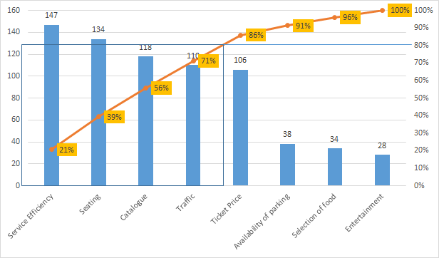
On the basis of “Number of complaints”, “Cumulative frequency” and “Cumulative percentage” Pareto analysis conducted. Diagram Mentioned below.

Slide 7
Pareto Diagram shows that “Service efficiency”, “Seating”, “Catalogue” and traffic are the categories which receives maximum numbers of complaints.
On resolving the said categories issues “AFL” committee will be able to eliminate the 80% of high risk complaints.

Slide 8
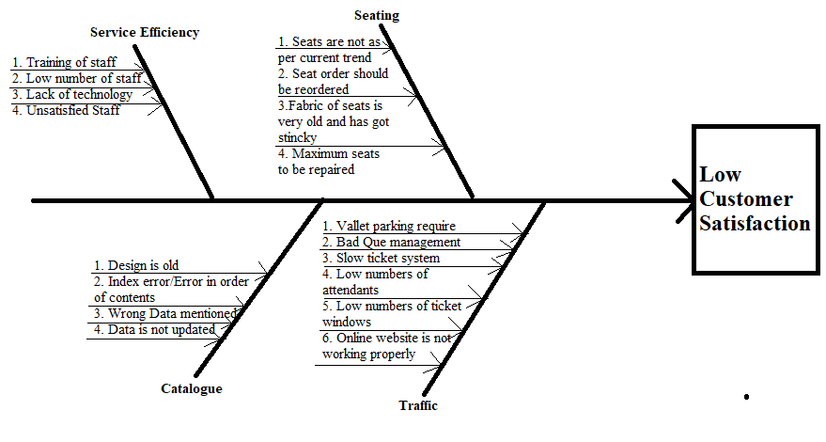
Cause and Effect Diagram (Fishbone Diagram)

